Slide 1
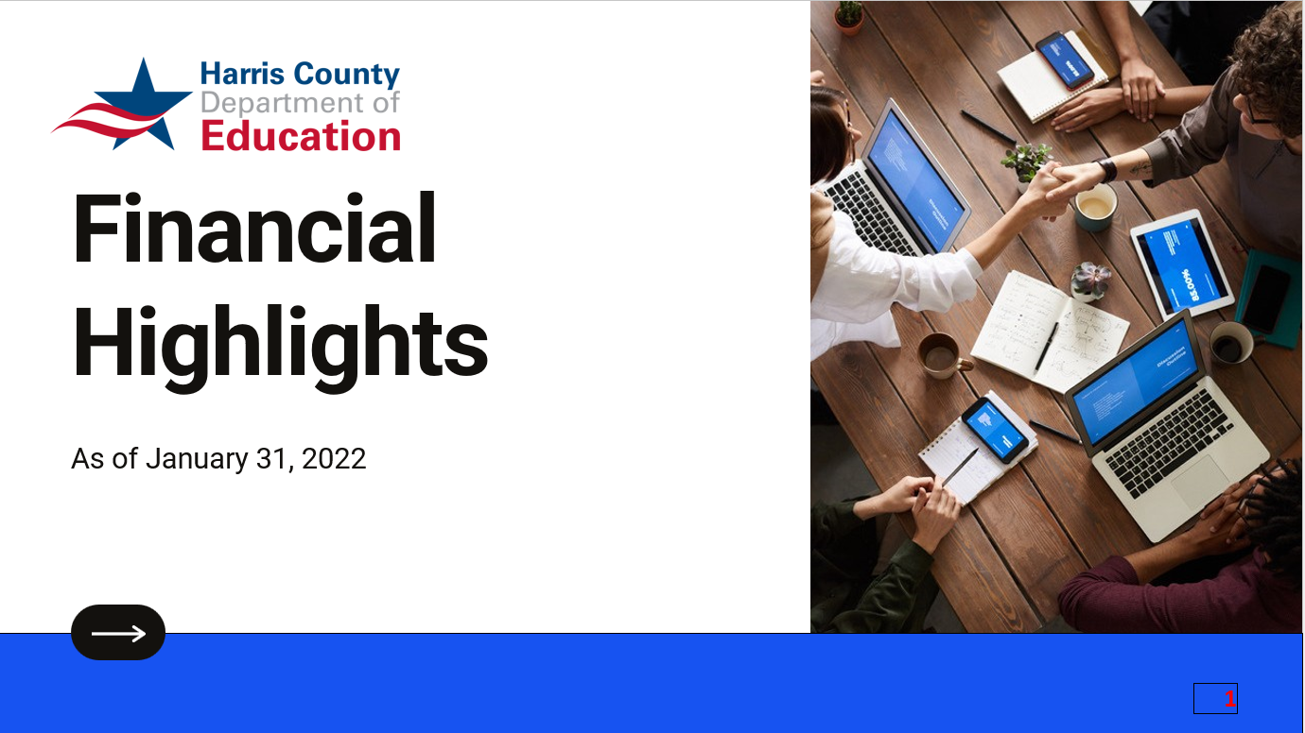


Financial Highlights
As of January 31, 2022

Slide 2
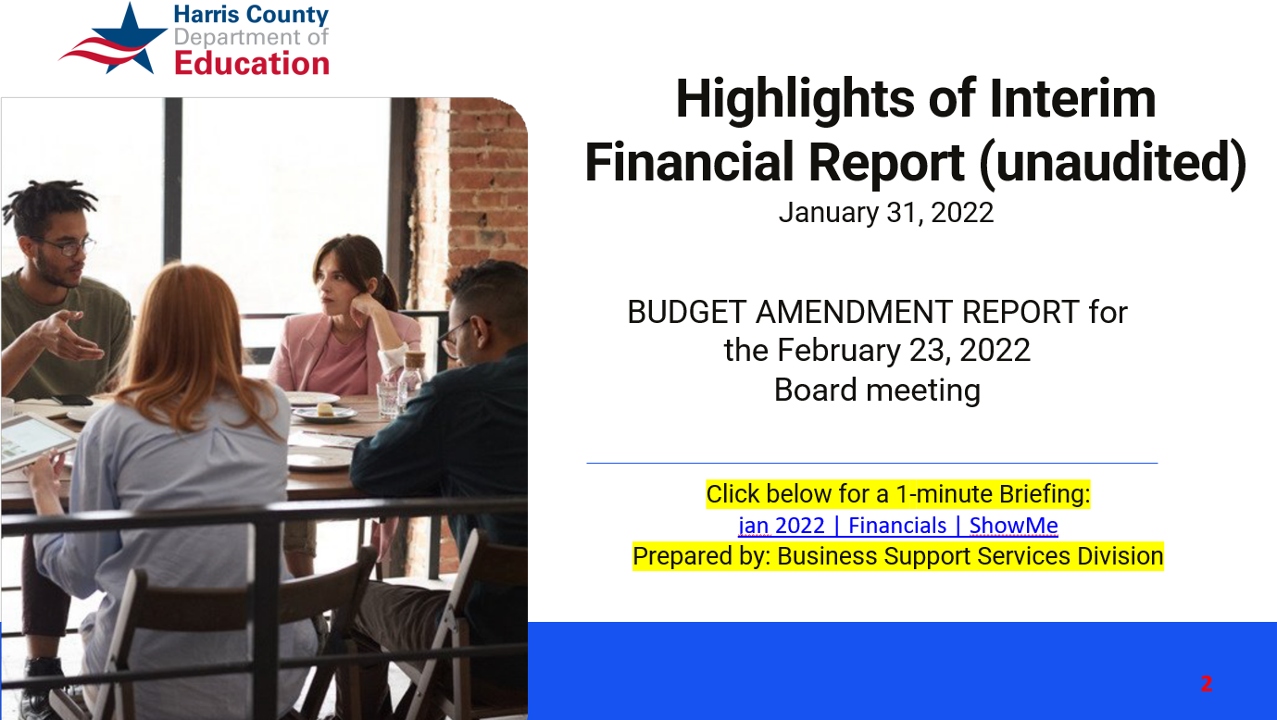

Highlights of Interim Financial Report (unaudited)
January 31, 2022
BUDGET AMENDMENT REPORT for the February 23, 2022
Board meeting
Click below for a 1-minute Briefing:
jan 2022 | Financials | ShowMe
Prepared by: Business Support Services Division

Slide 3
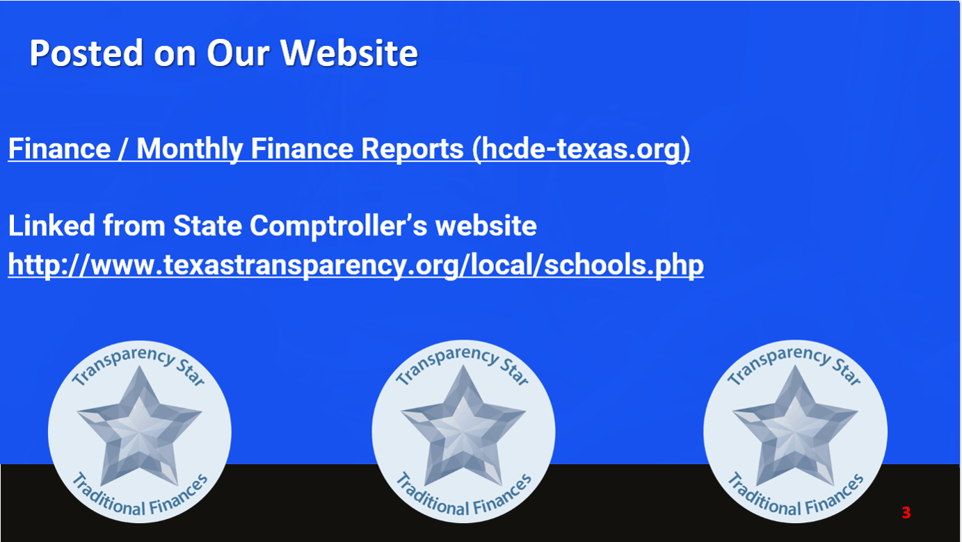
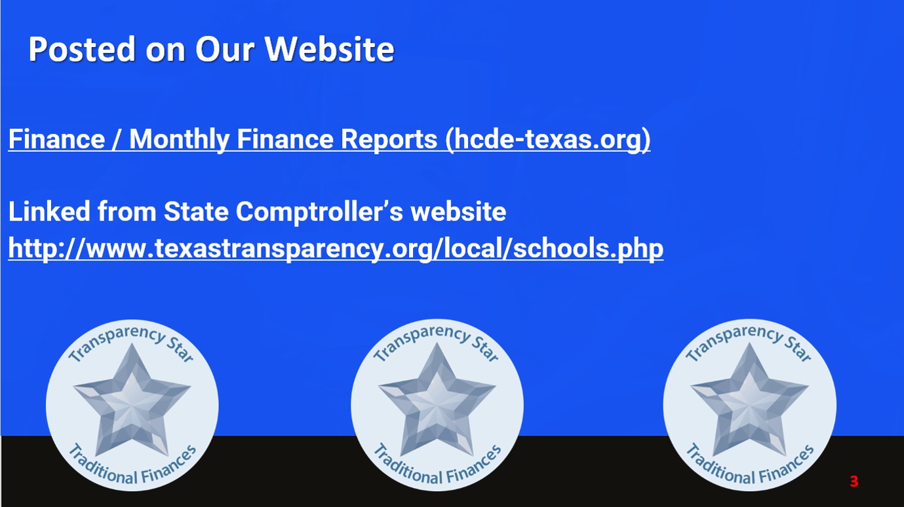
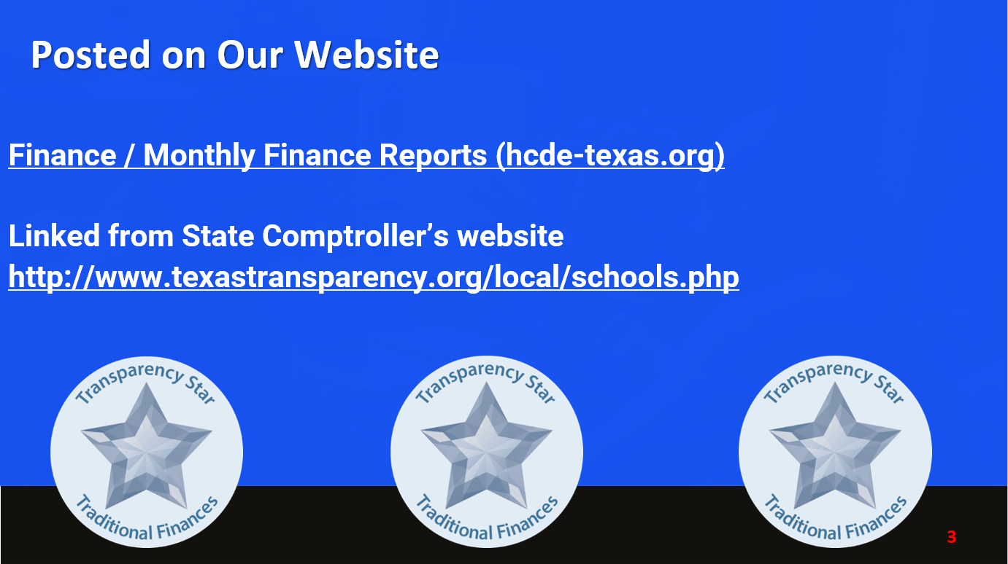



Posted on Our Website
Finance / Monthly Finance Reports (hcde-texas.org)
Linked from State Comptroller’s website
http://www.texastransparency.org/local/schools.php

Slide 4
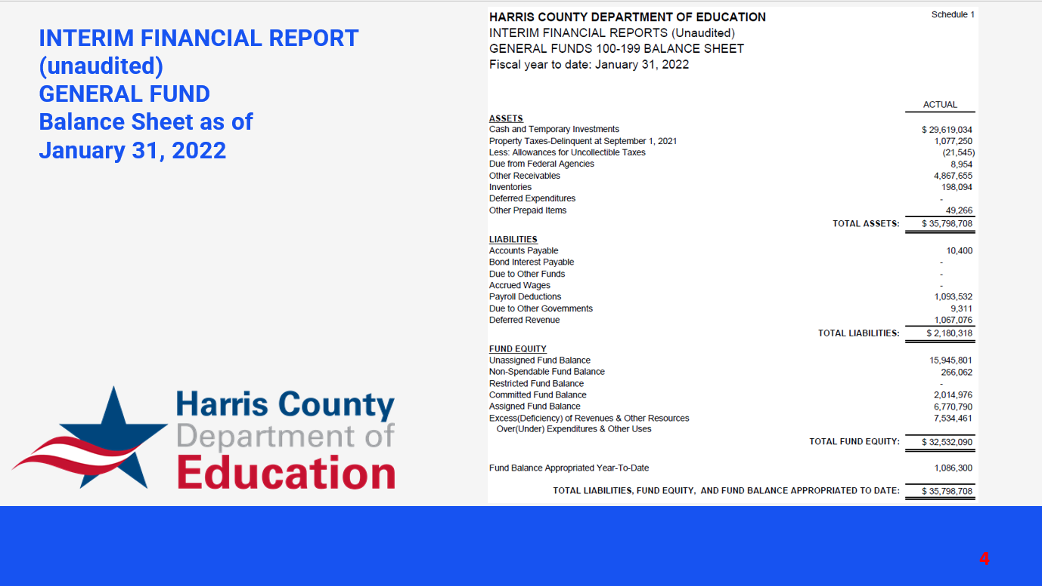
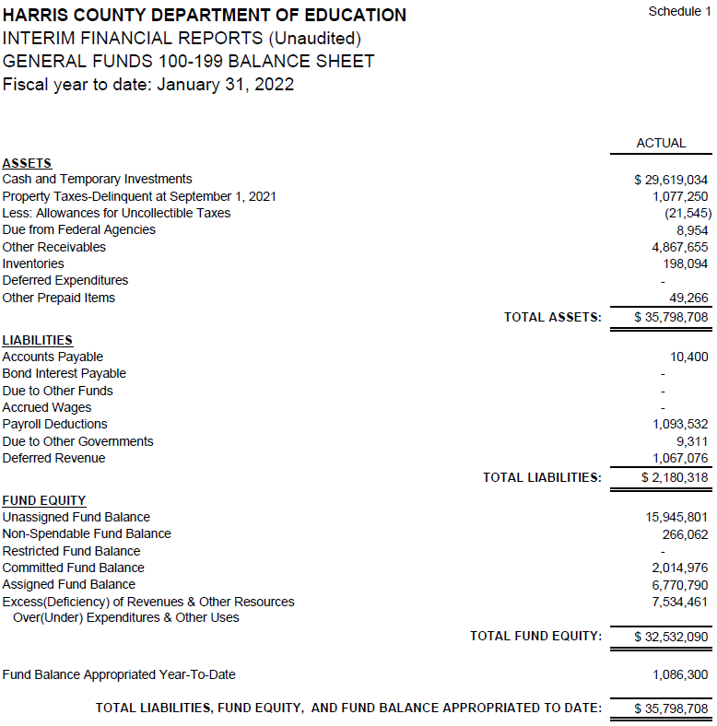

INTERIM FINANCIAL REPORT
(unaudited)
GENERAL FUND
Balance Sheet as of
January 31, 2022

Slide 5
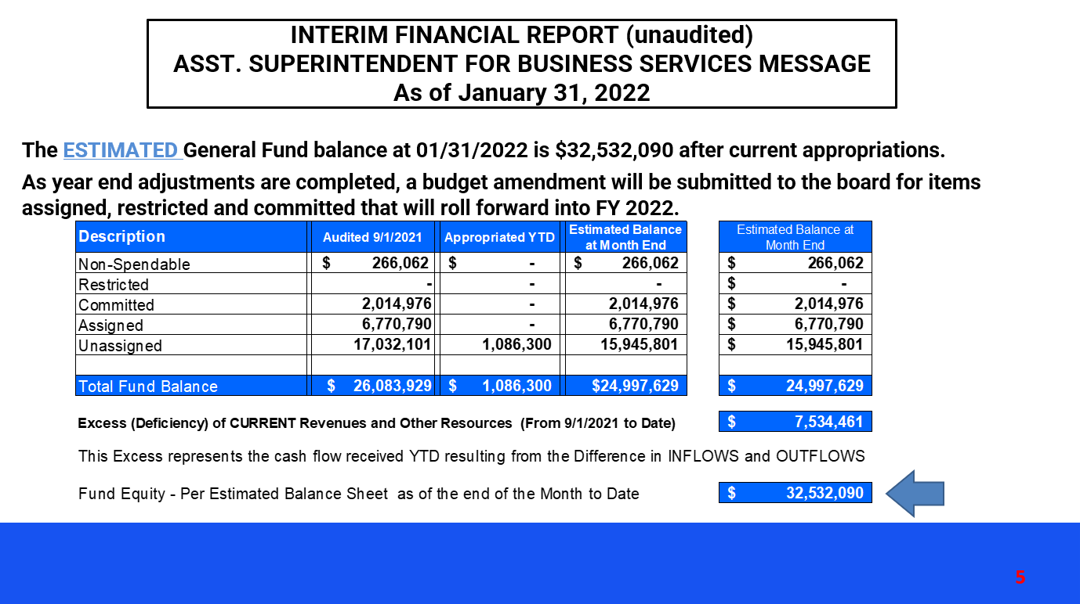
INTERIM FINANCIAL REPORT (unaudited)
ASST. SUPERINTENDENT FOR BUSINESS SERVICES MESSAGE
As of January 31, 2022
The ESTIMATED General Fund balance at 01/31/2022 is $32,532,090 after current appropriations.
As year end adjustments are completed, a budget amendment will be submitted to the board for items assigned, restricted and committed that will roll forward into FY 2022.

Slide 6
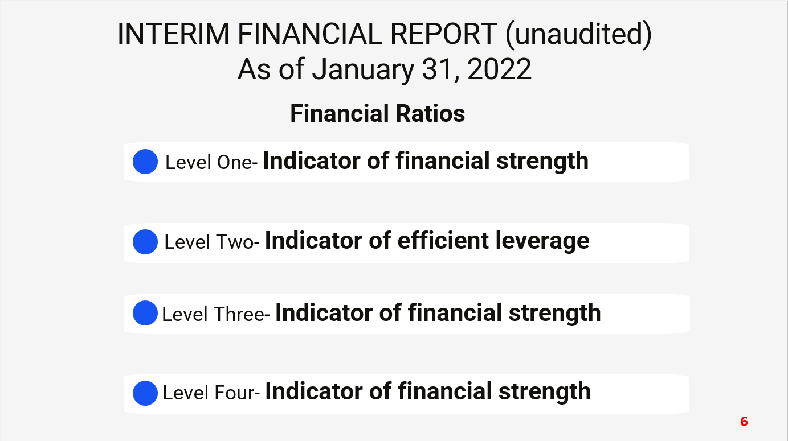

INTERIM FINANCIAL REPORT (unaudited)
As of January 31, 2022
Financial Ratios
Level One- Indicator of financial strength
Level Two- Indicator of efficient leverage
Level Three- Indicator of financial strength
Level Four- Indicator of financial strength

Slide 7

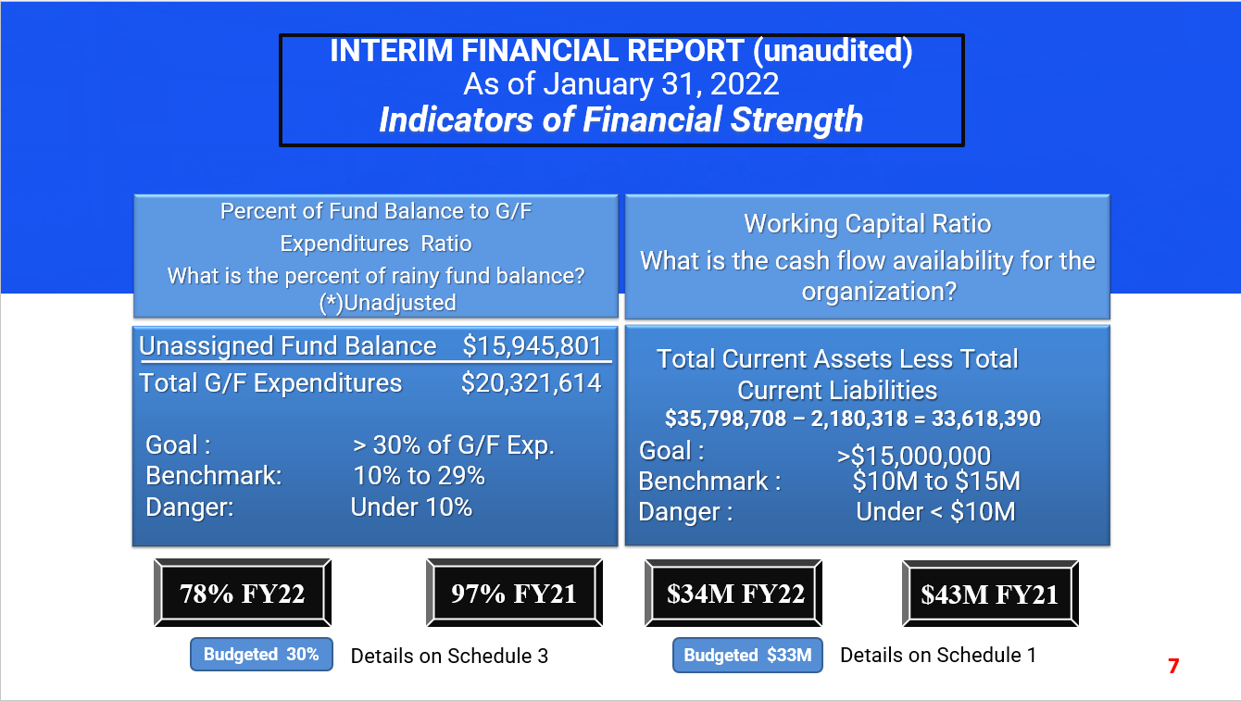
INTERIM FINANCIAL REPORT (unaudited)
As of January 31, 2022
Indicators of Financial Strength
Percent of Fund Balance to G/F
Expenditures Ratio
What is the percent of rainy fund balance? (*)Unadjusted
Working Capital Ratio
What is the cash flow availability for the organization?
Total Current Assets Less Total Current Liabilities
$35,798,708 – 2,180,318 = 33,618,390
Goal :
Unassigned Fund Balance $15,945,801
Total G/F Expenditures $20,321,614
Goal : > 30% of G/F Exp.
Benchmark: 10% to 29%
Danger: Under 10%
>$15,000,000
Benchmark : $10M to $15M
Danger : Under < $10M
78% FY22
97% FY21
$34M FY22
$43M FY21
Budgeted 30%
Details on Schedule 3
Budgeted $33M
Details on Schedule 1

Slide 8
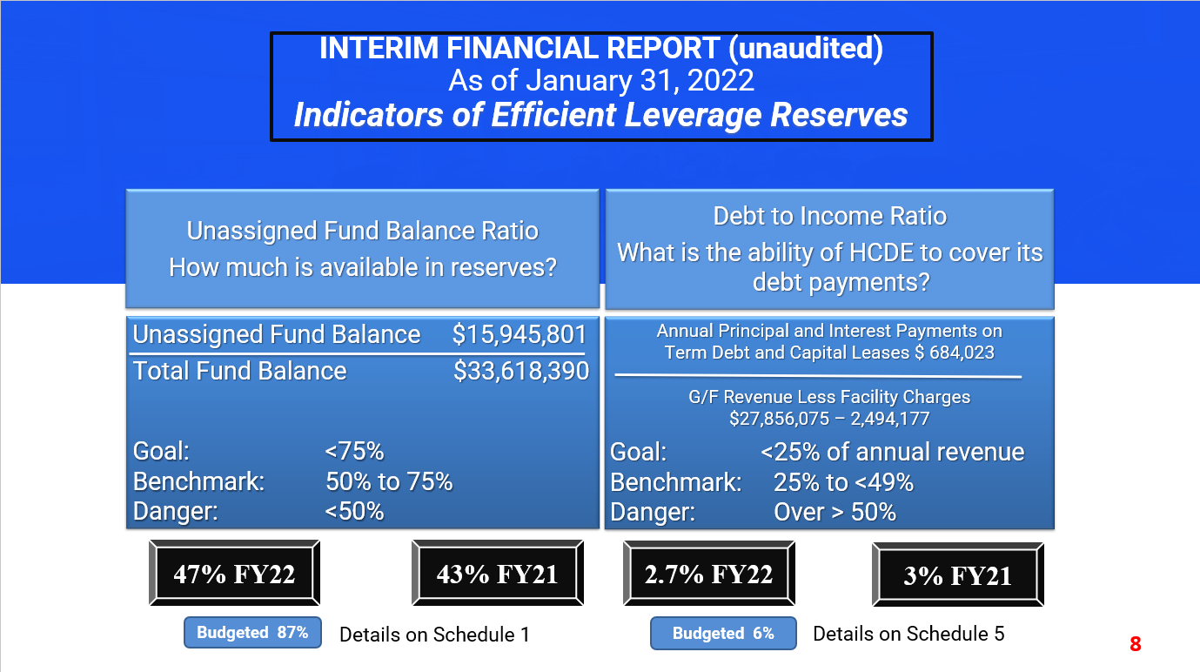
INTERIM FINANCIAL REPORT (unaudited)
As of January 31, 2022
Indicators of Efficient Leverage Reserves
Unassigned Fund Balance Ratio
How much is available in reserves?
Debt to Income Ratio
What is the ability of HCDE to cover its debt payments?
Unassigned Fund Balance $15,945,801
Total Fund Balance $33,618,390
Annual Principal and Interest Payments on
Term Debt and Capital Leases $ 684,023
G/F Revenue Less Facility Charges
$27,856,075 – 2,494,177
Goal: <75%
Benchmark: 50% to 75%
Danger: <50%
Goal: <25% of annual revenue
Benchmark: 25% to <49%
Danger: Over > 50%
47% FY22
43% FY21
2.7% FY22
3% FY21
Budgeted 87%
Details on Schedule 1
Budgeted 6%
Details on Schedule 5

Slide 9
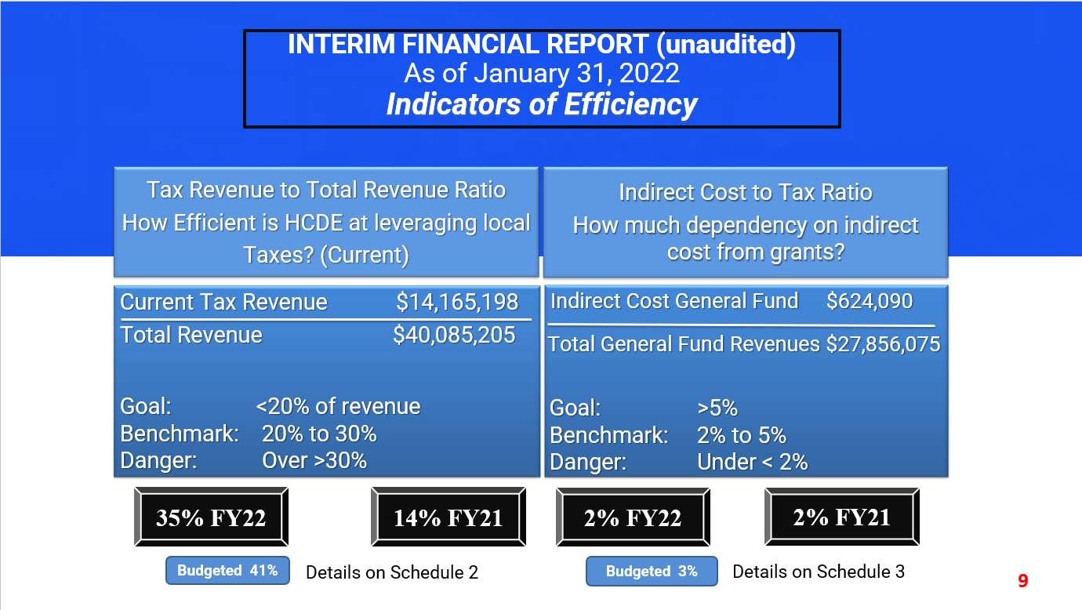
INTERIM FINANCIAL REPORT (unaudited)
As of January 31, 2022
Indicators of Efficiency
Tax Revenue to Total Revenue Ratio
How Efficient is HCDE at leveraging local
Taxes? (Current)
Indirect Cost to Tax Ratio
How much dependency on indirect cost from grants?
Current Tax Revenue $14,165,198
Total Revenue $40,085,205
Indirect Cost General Fund $624,090
Total General Fund Revenues $27,856,075
Goal: <20% of revenue
Benchmark: 20% to 30%
Danger: Over >30%
Goal: >5%
Benchmark: 2% to 5%
Danger: Under < 2%
35% FY22
14% FY21
2% FY22
2% FY21
Budgeted 41%
Details on Schedule 2
Budgeted 3%
Details on Schedule 3

Slide 10
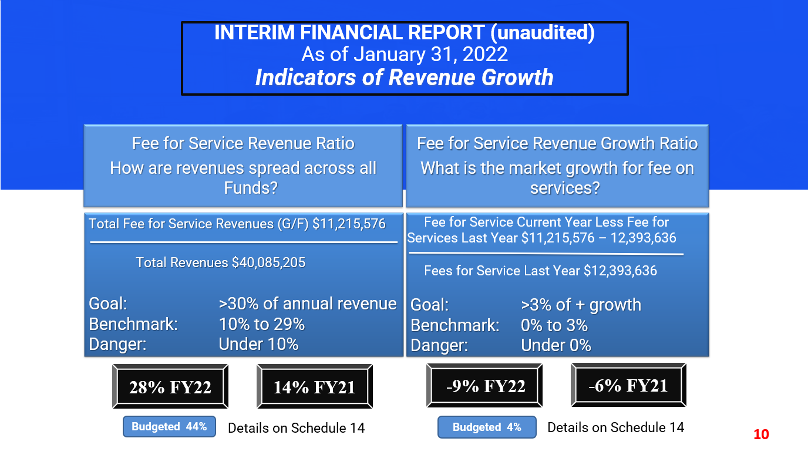
INTERIM FINANCIAL REPORT (unaudited)
As of January 31, 2022
Indicators of Revenue Growth
Fee for Service Revenue Ratio
How are revenues spread across all Funds?
Fee for Service Revenue Growth Ratio
What is the market growth for fee on services?
Total Fee for Service Revenues (G/F) $11,215,576
Total Revenues $40,085,205
Fee for Service Current Year Less Fee for Services Last Year $11,215,576 – 12,393,636
Fees for Service Last Year $12,393,636
Goal: >30% of annual revenue Benchmark: 10% to 29%
Danger: Under 10%
Goal: >3% of + growth
Benchmark: 0% to 3%
Danger: Under 0%
28% FY22
14% FY21
-9% FY22
-6% FY21
Budgeted 44%
Details on Schedule 14
Budgeted 4%
Details on Schedule 14

Slide 11
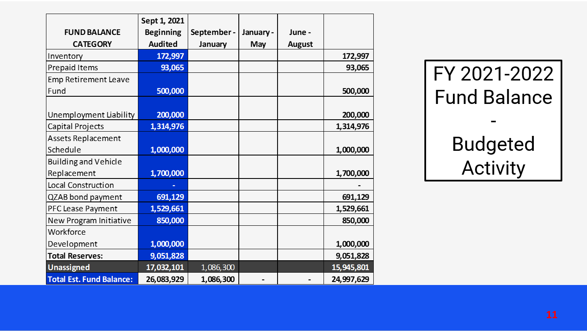
FY 2021-2022
Fund Balance
-
Budgeted Activity

Slide 12
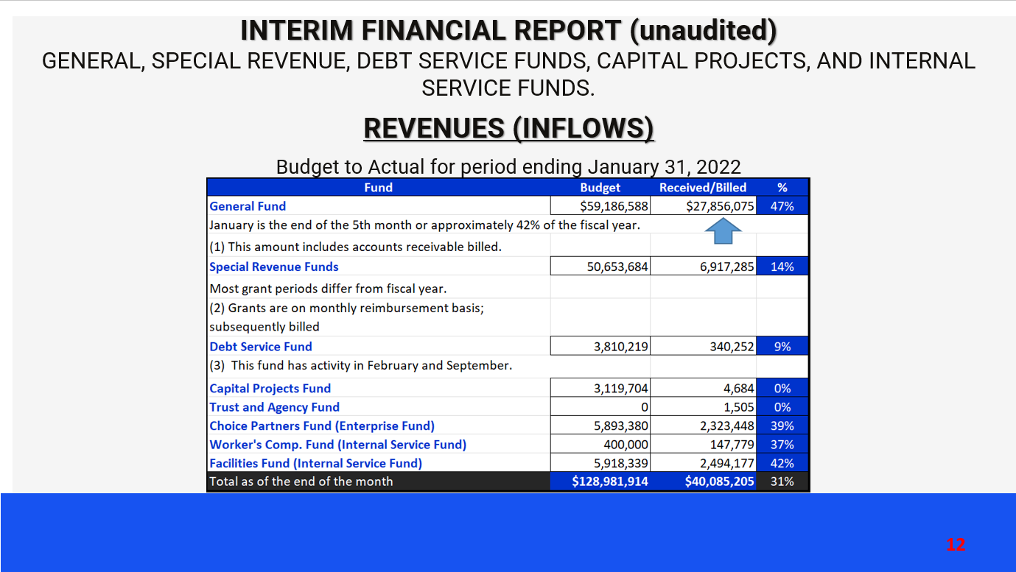
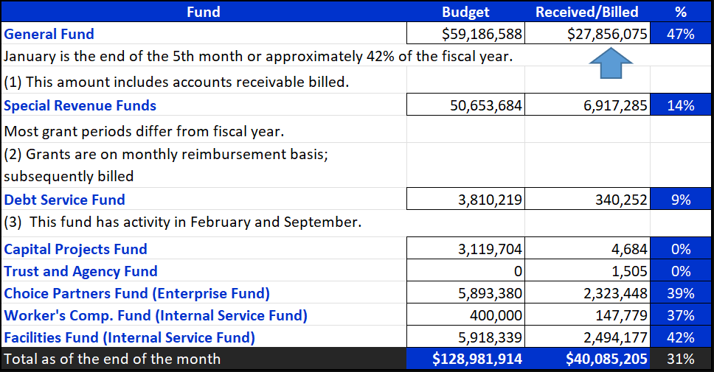
INTERIM FINANCIAL REPORT (unaudited)
GENERAL, SPECIAL REVENUE, DEBT SERVICE FUNDS, CAPITAL PROJECTS, AND INTERNAL SERVICE FUNDS.
REVENUES (INFLOWS)
Budget to Actual for period ending January 31, 2022

Slide 13
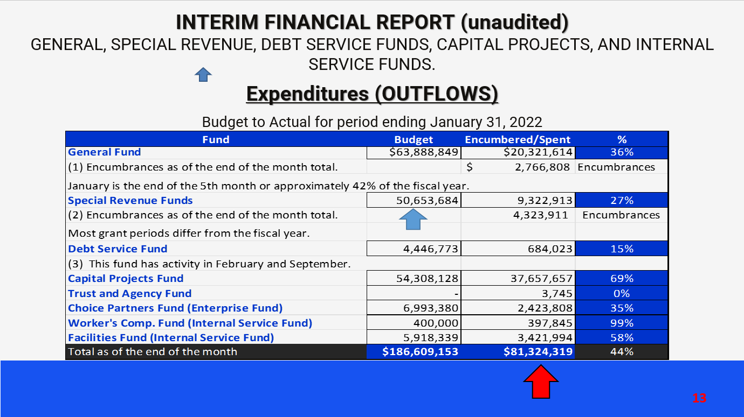
INTERIM FINANCIAL REPORT (unaudited)
GENERAL, SPECIAL REVENUE, DEBT SERVICE FUNDS, CAPITAL PROJECTS, AND INTERNAL SERVICE FUNDS.
Expenditures (OUTFLOWS)
Budget to Actual for period ending January 31, 2022

Slide 14
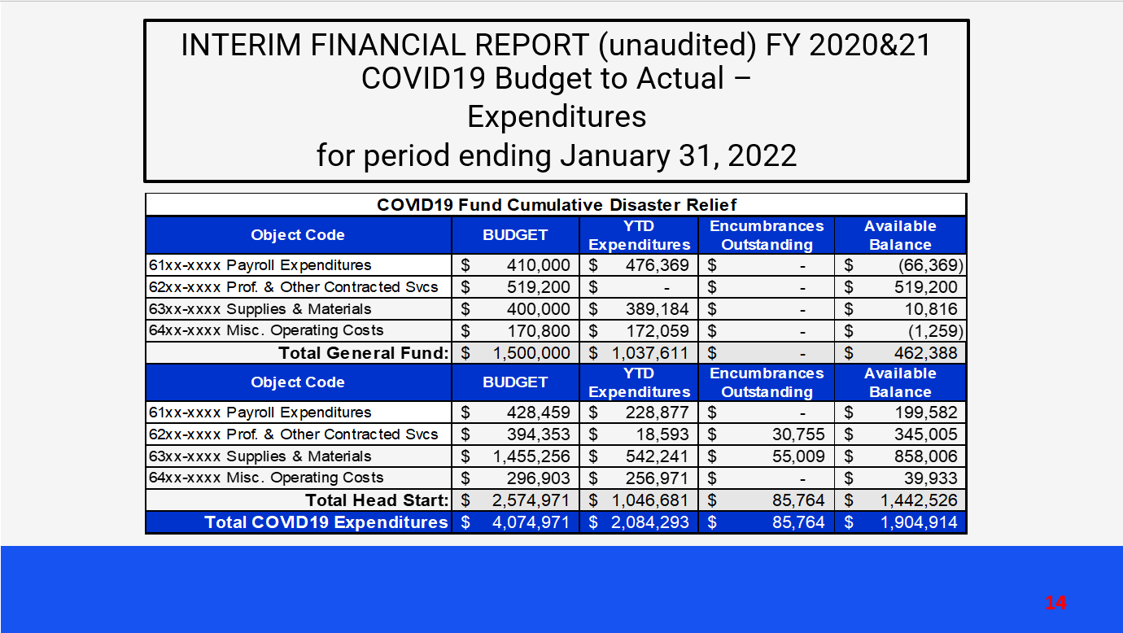
INTERIM FINANCIAL REPORT (unaudited) FY 2020&21 COVID19 Budget to Actual –
Expenditures
for period ending January 31, 2022

Slide 15
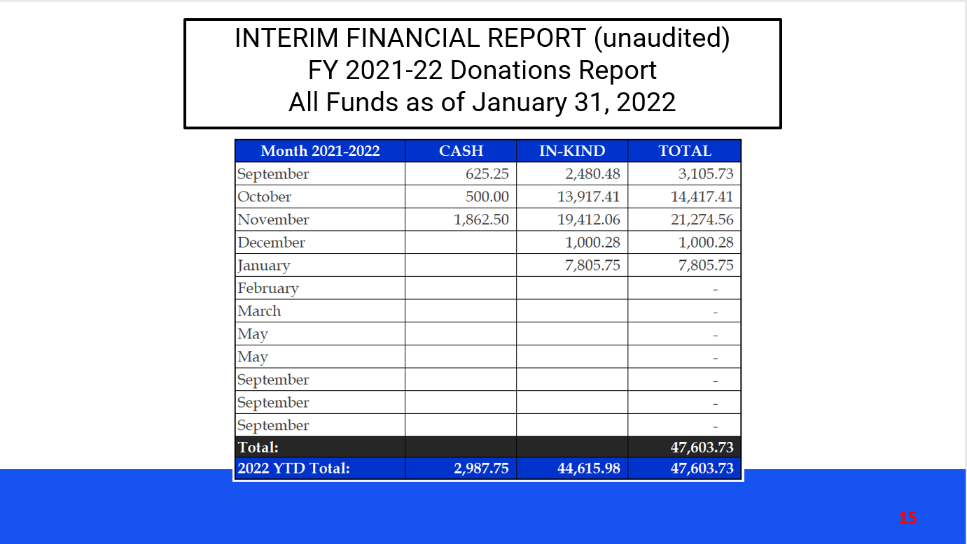
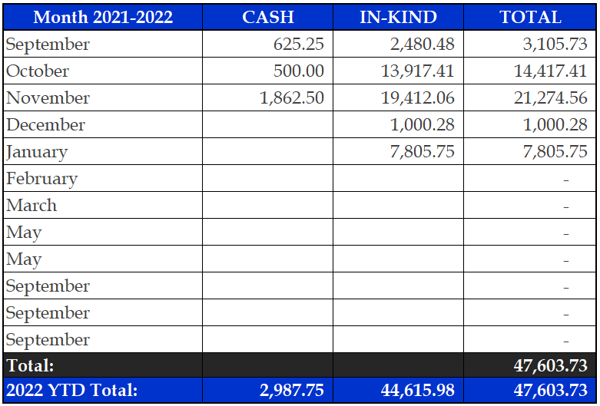
INTERIM FINANCIAL REPORT (unaudited)
FY 2021-22 Donations Report
All Funds as of January 31, 2022

Slide 16
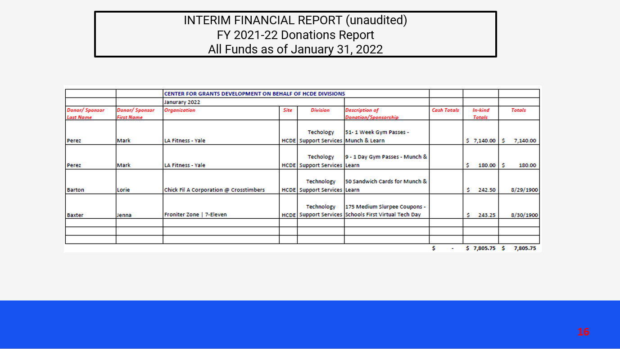
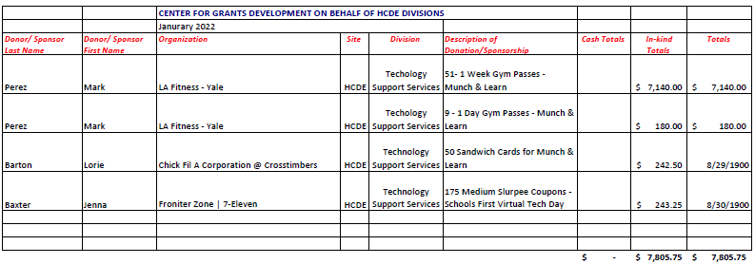
INTERIM FINANCIAL REPORT (unaudited)
FY 2021-22 Donations Report
All Funds as of January 31, 2022

Slide 17
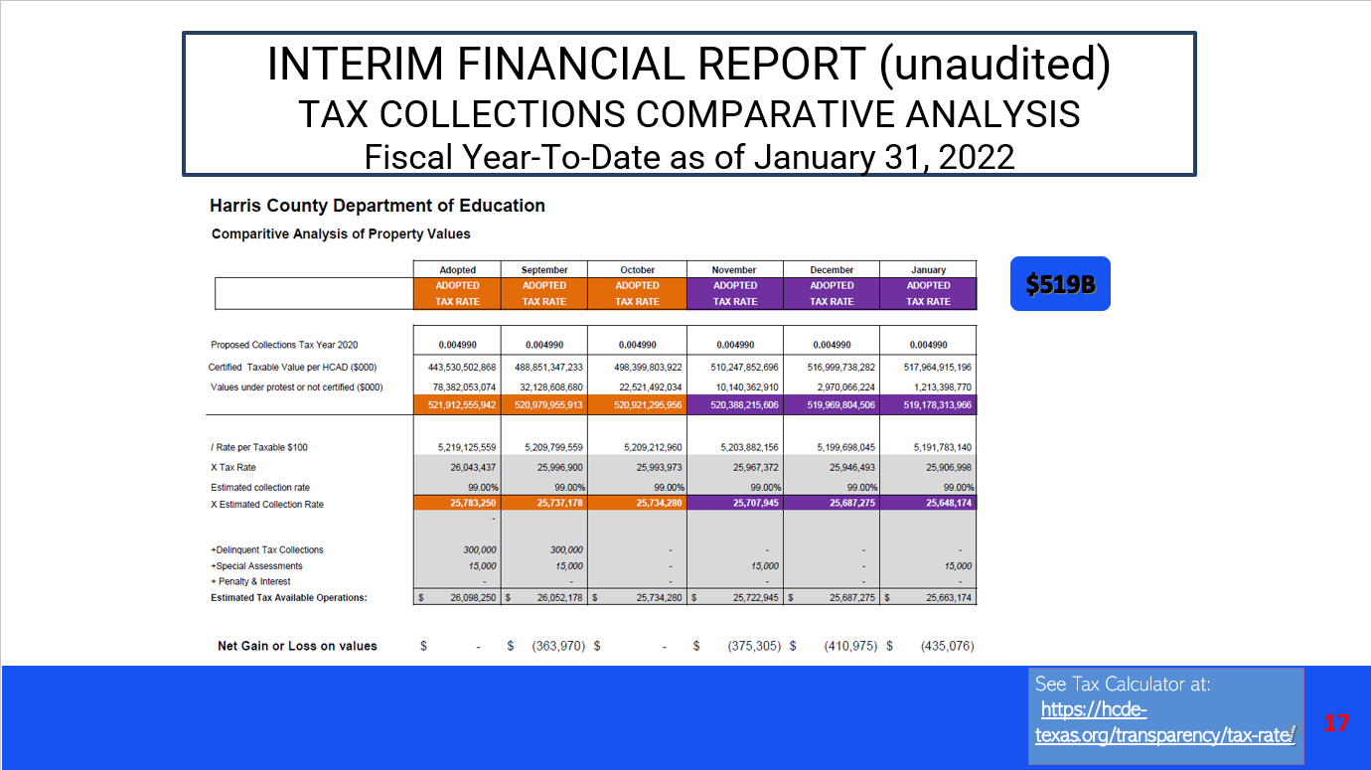
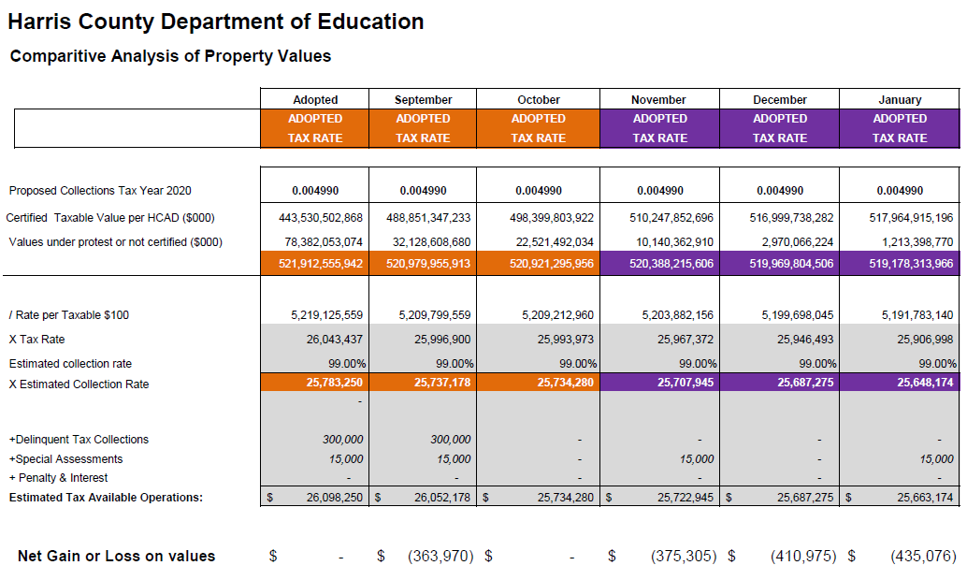
INTERIM FINANCIAL REPORT (unaudited)
TAX COLLECTIONS COMPARATIVE ANALYSIS
Fiscal Year-To-Date as of January 31, 2022
$519B
See Tax Calculator at:
https://hcde-texas.org/transparency/tax-rate/
17

Slide 18
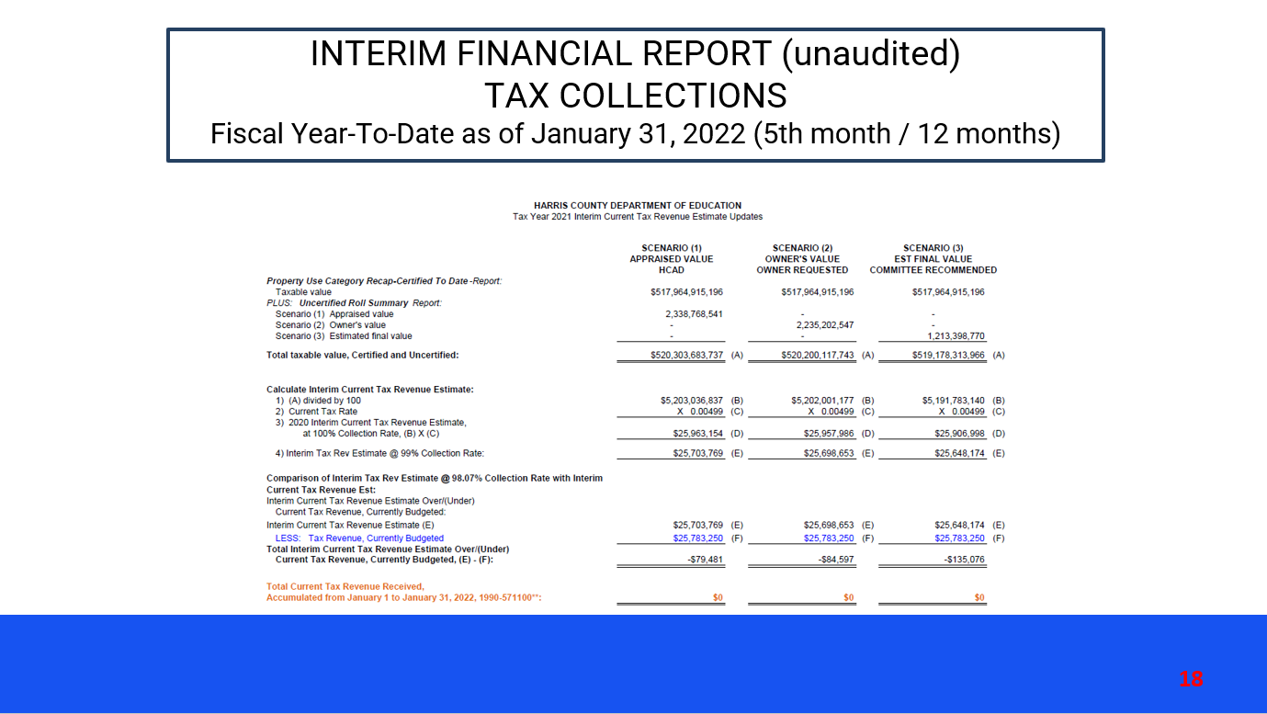
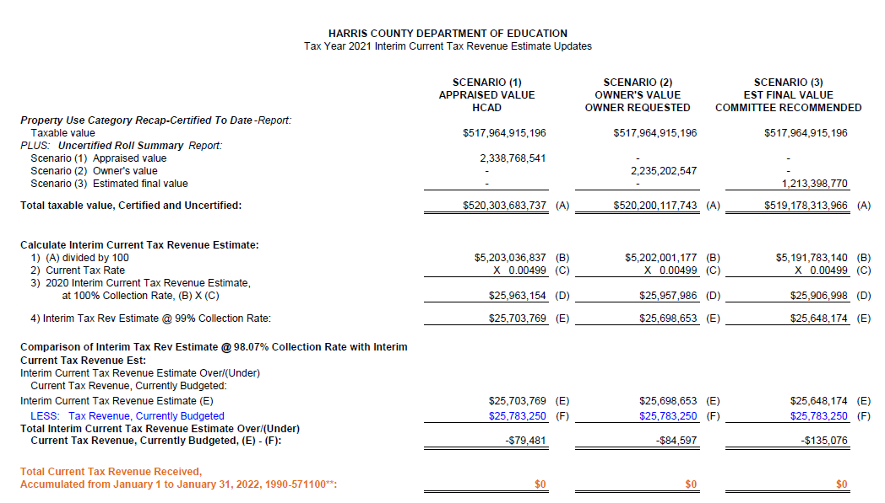
INTERIM FINANCIAL REPORT (unaudited)
TAX COLLECTIONS
Fiscal Year-To-Date as of January 31, 2022 (5th month / 12 months)

Slide 19
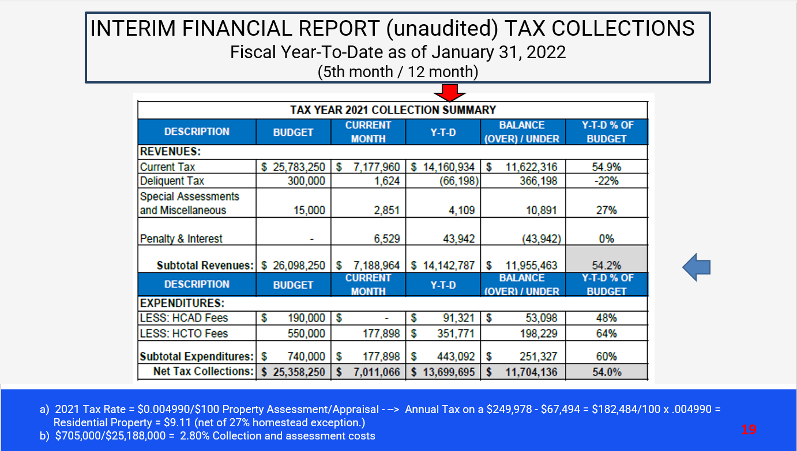
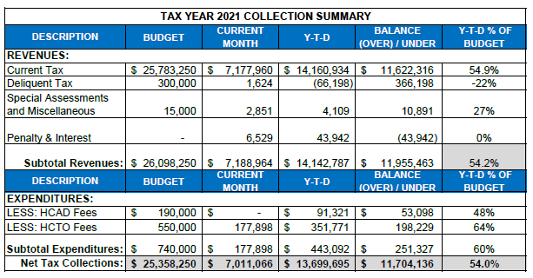
INTERIM FINANCIAL REPORT (unaudited) TAX COLLECTIONS
Fiscal Year-To-Date as of January 31, 2022
(5th month / 12 month)
a) 2021 Tax Rate = $0.004990/$100 Property Assessment/Appraisal - --> Annual Tax on a $249,978 - $67,494 = $182,484/100 x .004990 =
Residential Property = $9.11 (net of 27% homestead exception.)
b) $705,000/$25,188,000 = 2.80% Collection and assessment costs

Slide 20
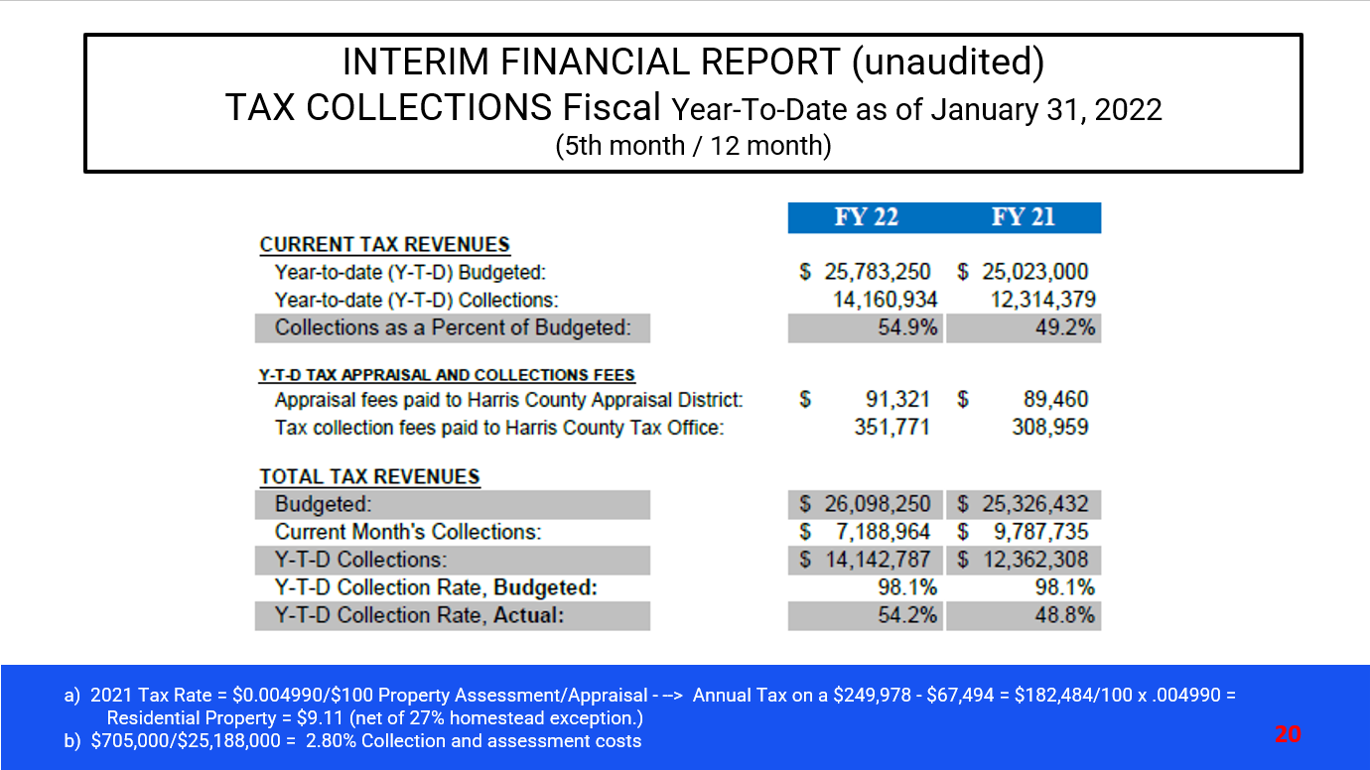
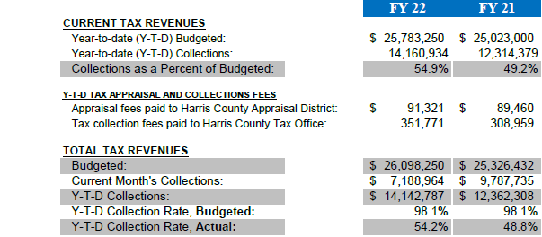
INTERIM FINANCIAL REPORT (unaudited)
TAX COLLECTIONS Fiscal Year-To-Date as of January 31, 2022
(5th month / 12 month)
a) 2021 Tax Rate = $0.004990/$100 Property Assessment/Appraisal - --> Annual Tax on a $249,978 - $67,494 = $182,484/100 x .004990 =
Residential Property = $9.11 (net of 27% homestead exception.)
b) $705,000/$25,188,000 = 2.80% Collection and assessment costs

Slide 21

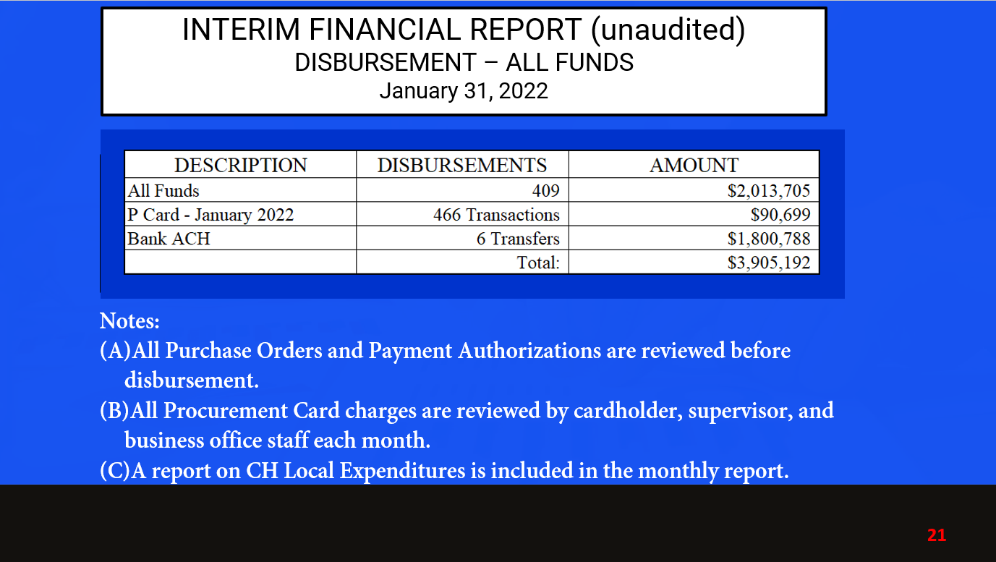
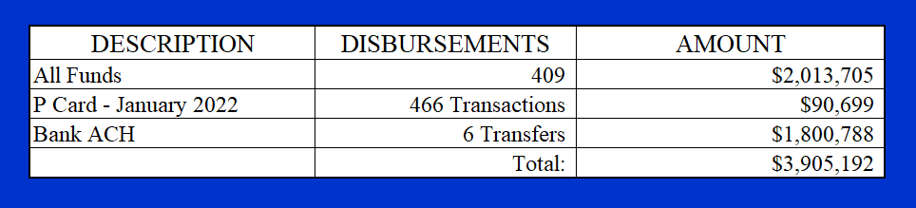
INTERIM FINANCIAL REPORT (unaudited)
DISBURSEMENT – ALL FUNDS
January 31, 2022
Notes:
All Purchase Orders and Payment Authorizations are reviewed before disbursement.
All Procurement Card charges are reviewed by cardholder, supervisor, and business office staff each month.
A report on CH Local Expenditures is included in the monthly report.

Slide 22
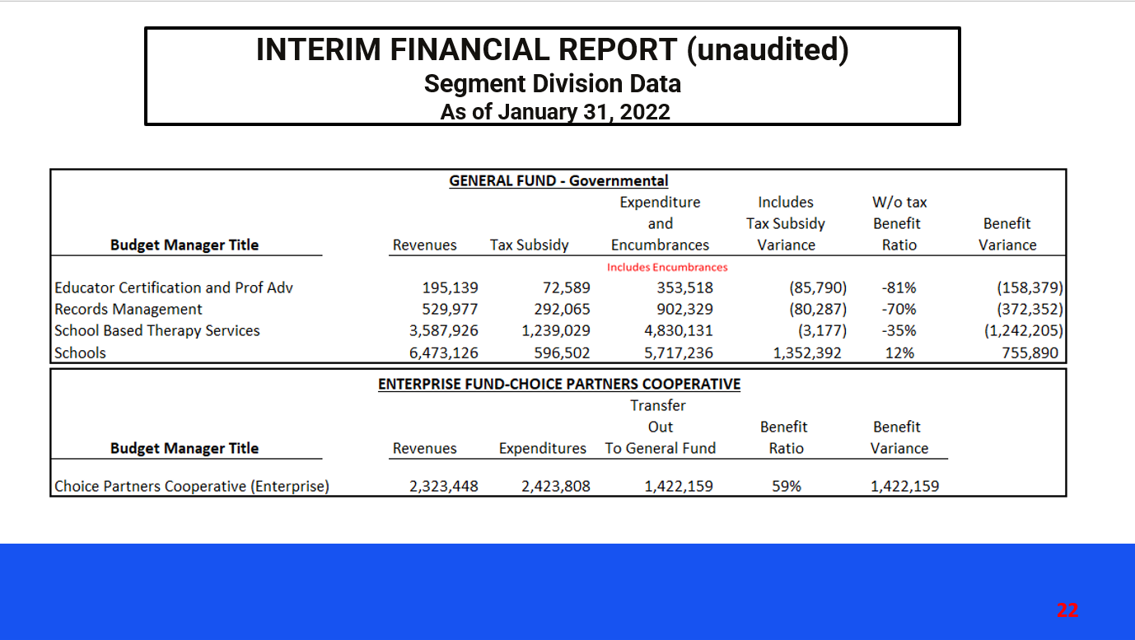
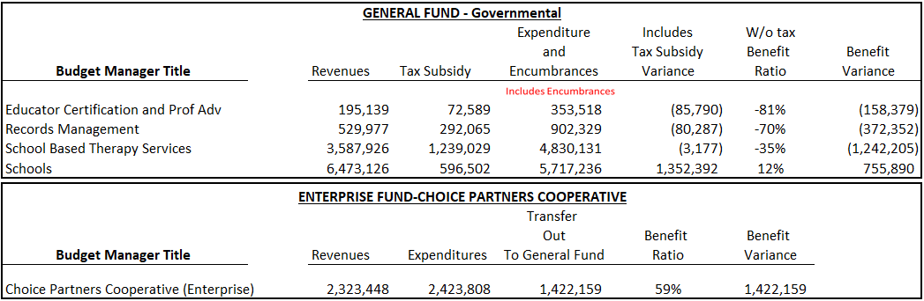
INTERIM FINANCIAL REPORT (unaudited)
Segment Division Data
As of January 31, 2022

Slide 23
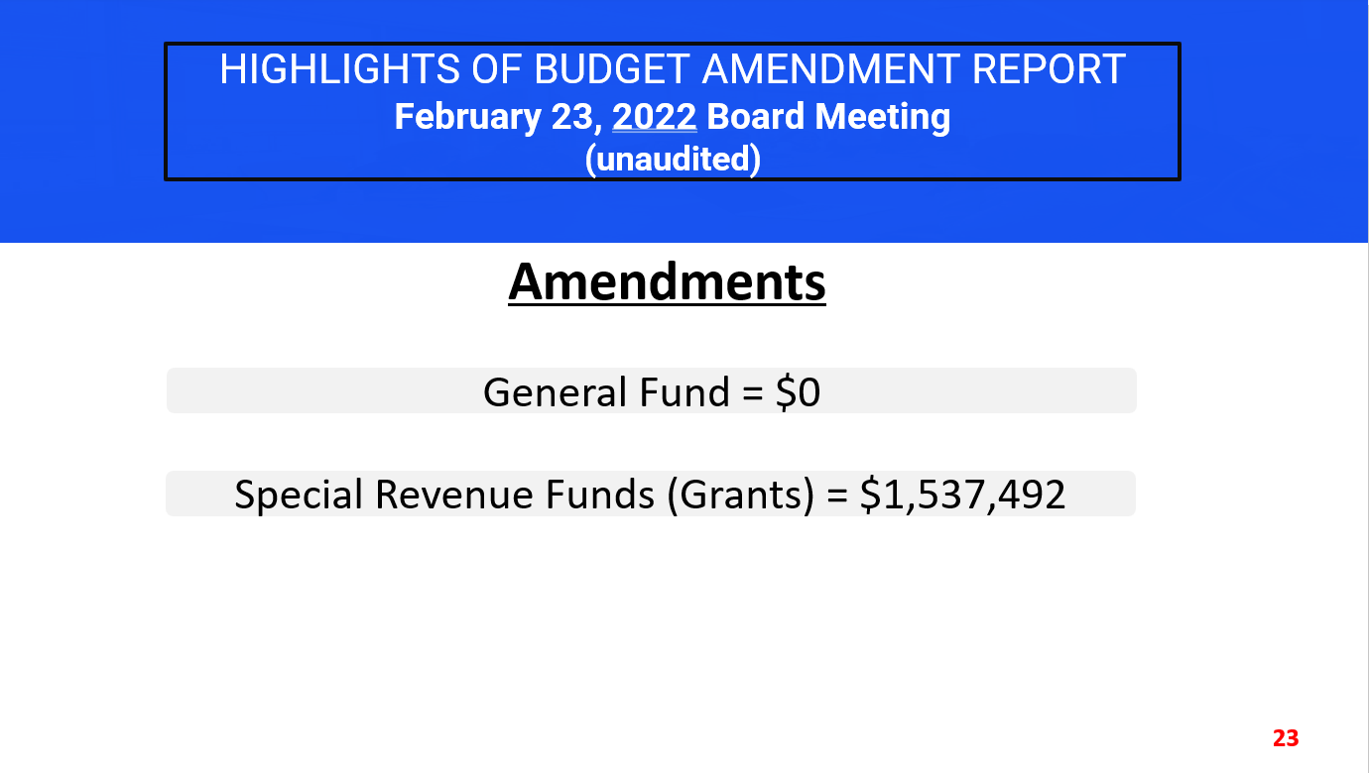
HIGHLIGHTS OF BUDGET AMENDMENT REPORT
February 23, 2022 Board Meeting
(unaudited)
Amendments
General Fund = $0
Special Revenue Funds (Grants) = $1,537,492

Slide 24
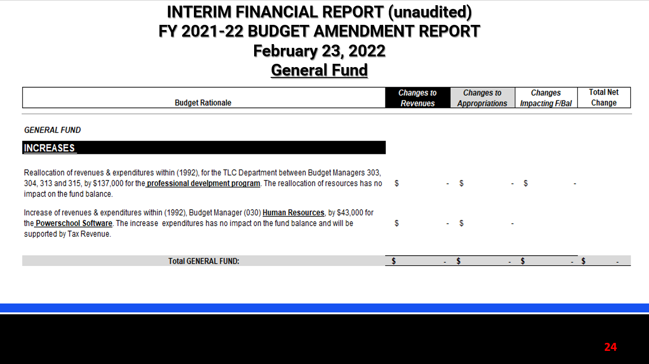
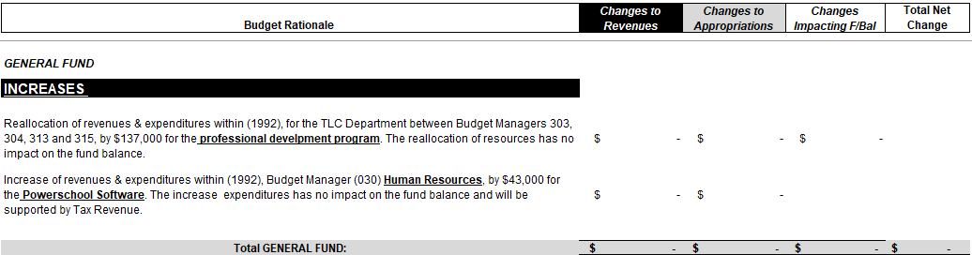
INTERIM FINANCIAL REPORT (unaudited)
FY 2021-22 BUDGET AMENDMENT REPORT
February 23, 2022
General Fund

Slide 25
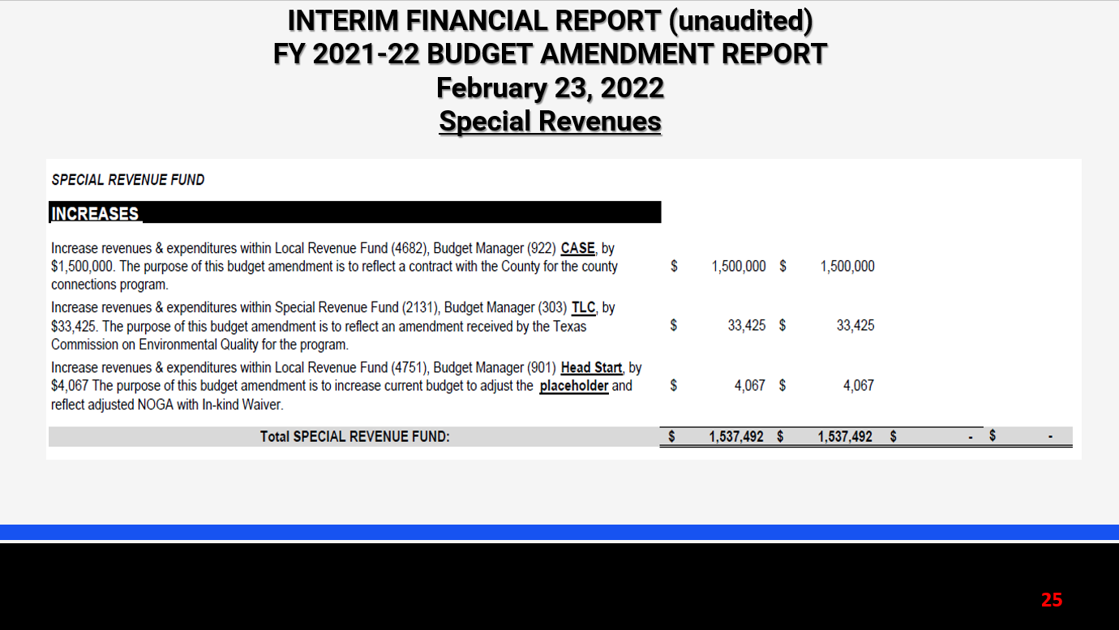
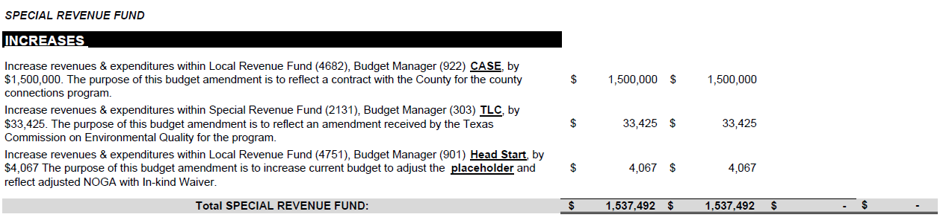
INTERIM FINANCIAL REPORT (unaudited)
FY 2021-22 BUDGET AMENDMENT REPORT
February 23, 2022
Special Revenues

Slide 26


Education Foundation Update
January 31, 2022

Slide 27
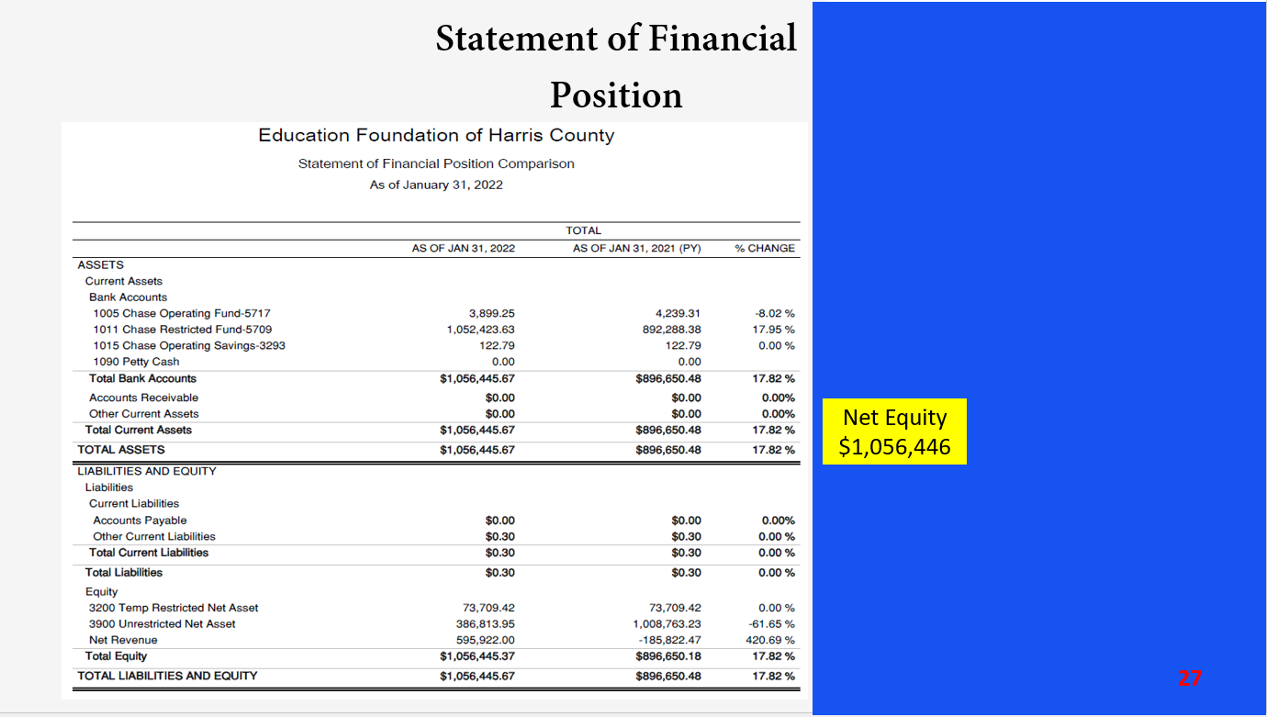
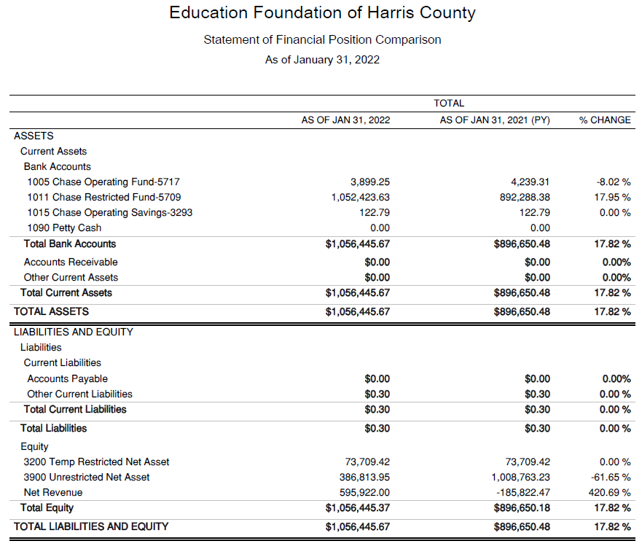
Statement of Financial Position
Net Equity $1,056,446

Slide 28
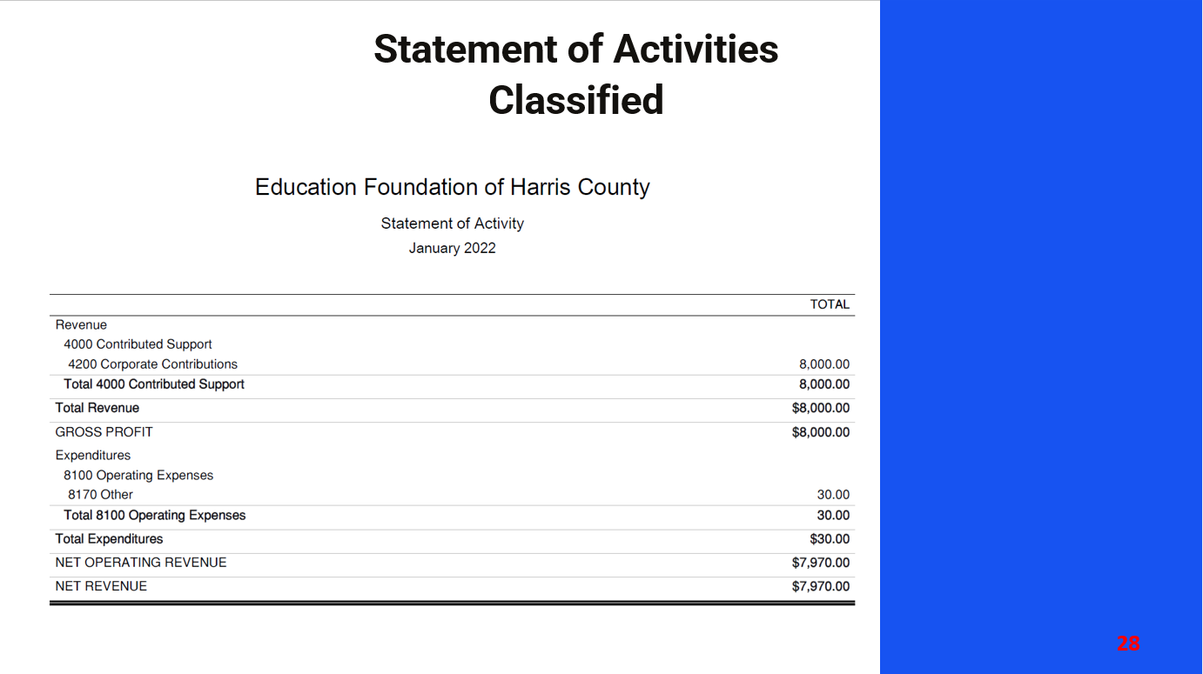
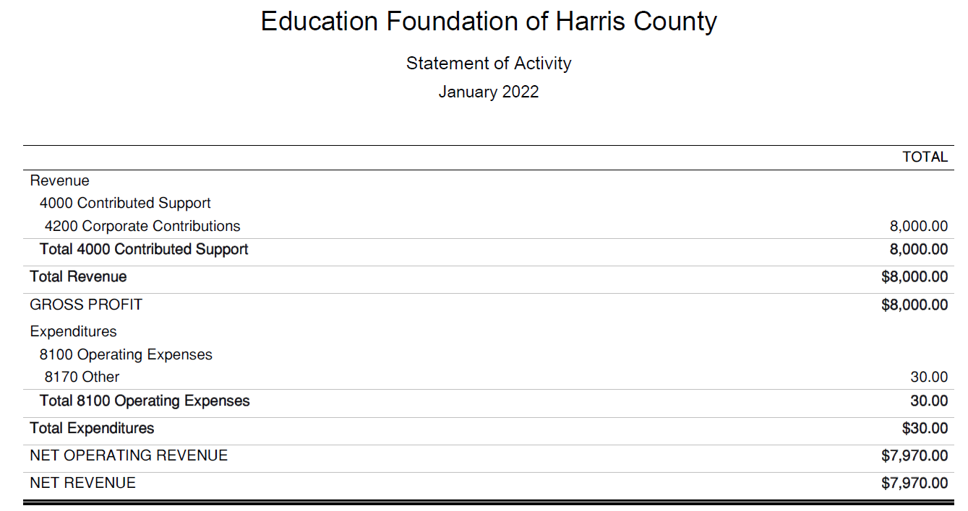
Statement of Activities Classified

Slide 29
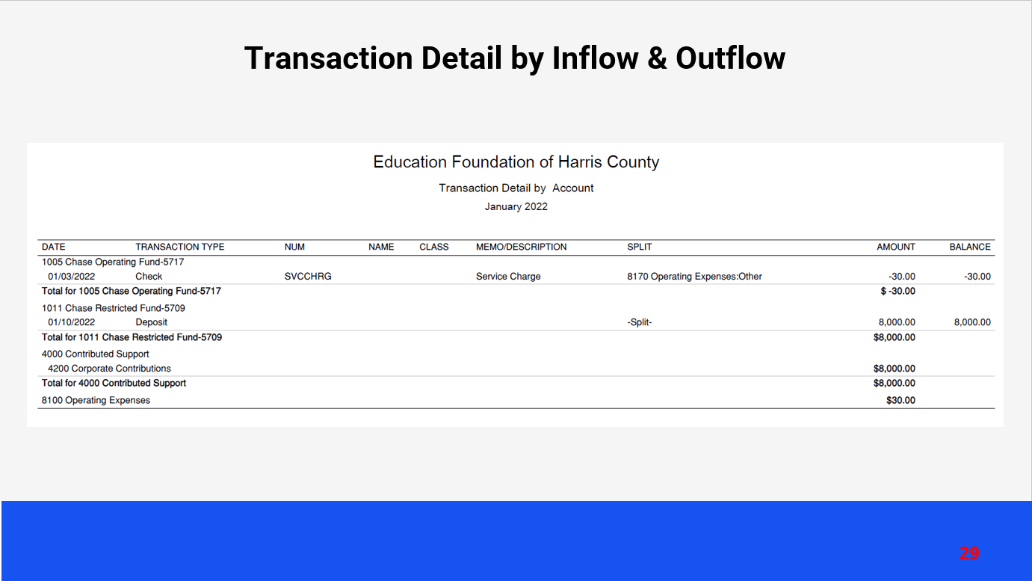
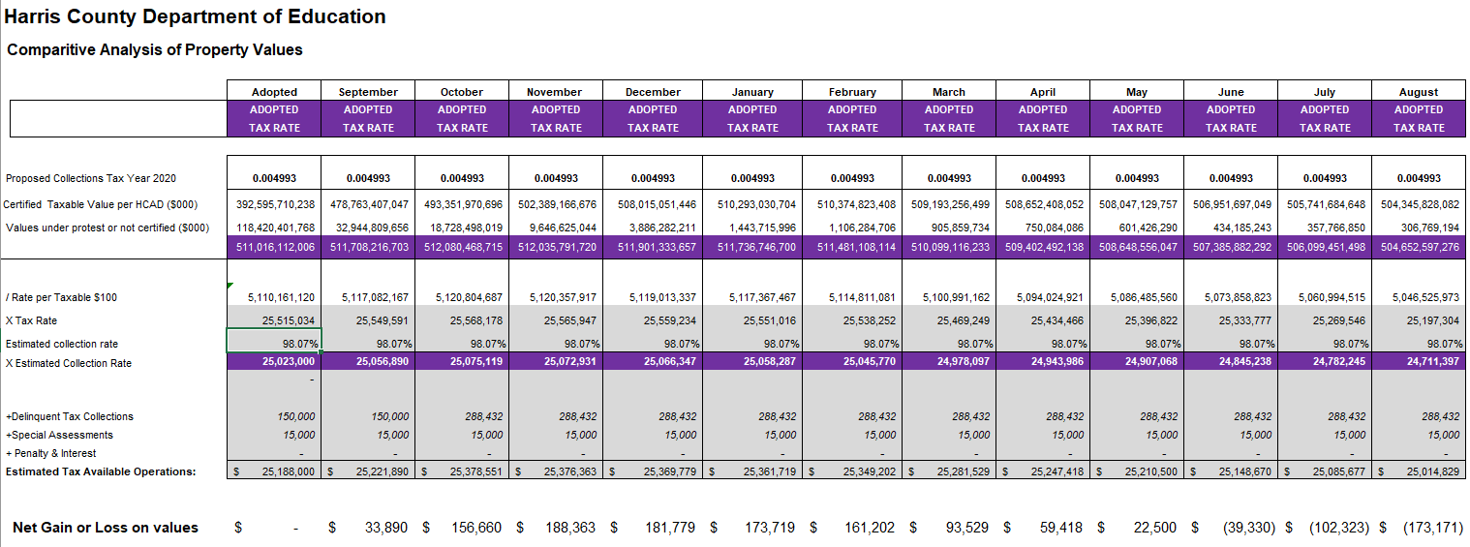
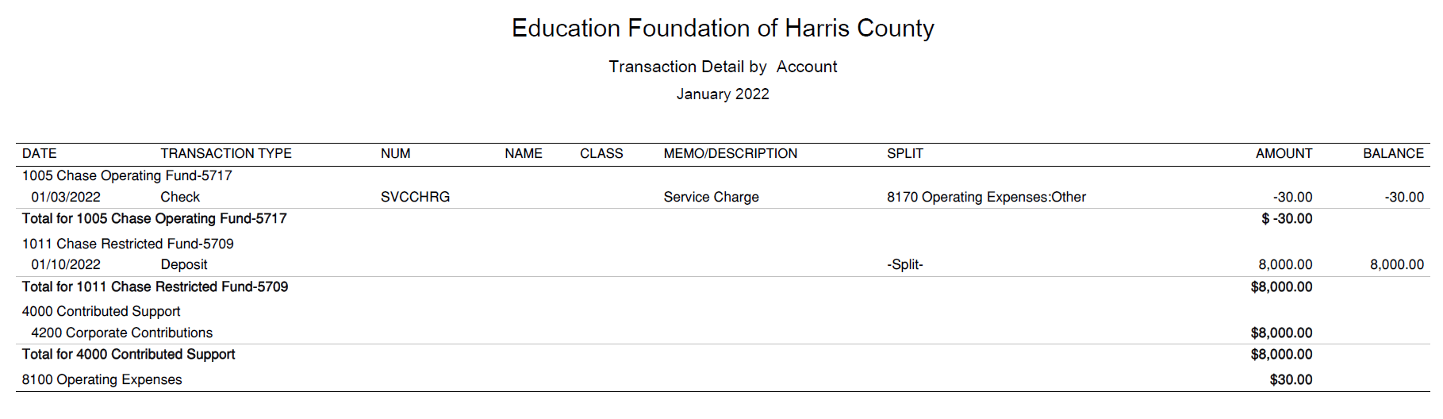




Transaction Detail by Inflow & Outflow
INTERIM FINANCIAL REPORT (unaudited)
TAX COLLECTIONS COMPARATIVE ANALYSIS
Fiscal Year-To-Date as of October 31, 2021
$505 B

Slide 30
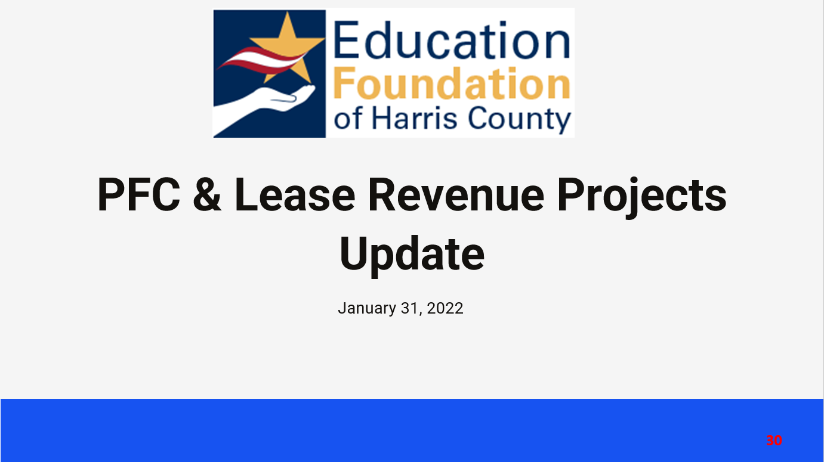
PFC & Lease Revenue Projects Update
January 31, 2022

Slide 31
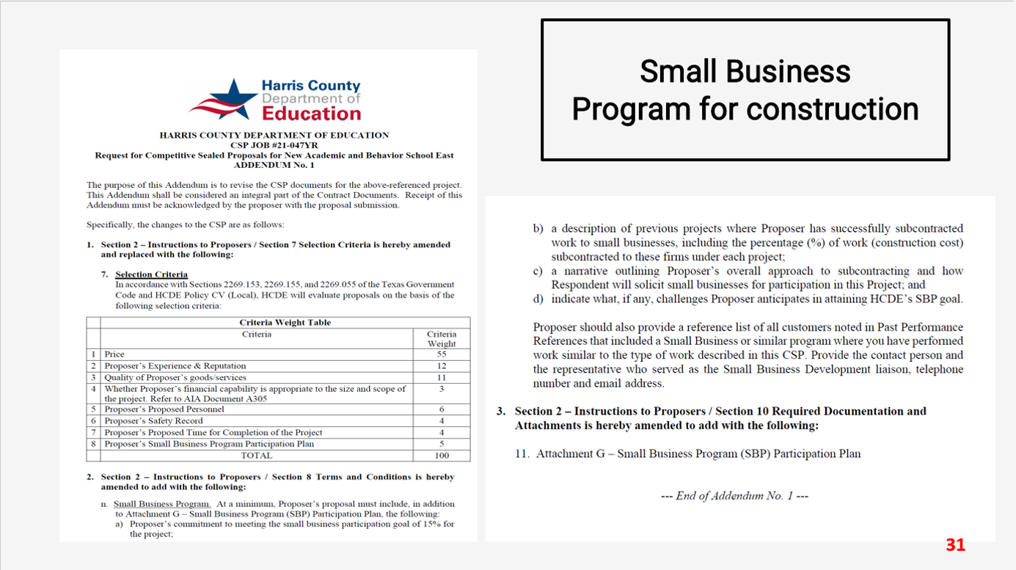

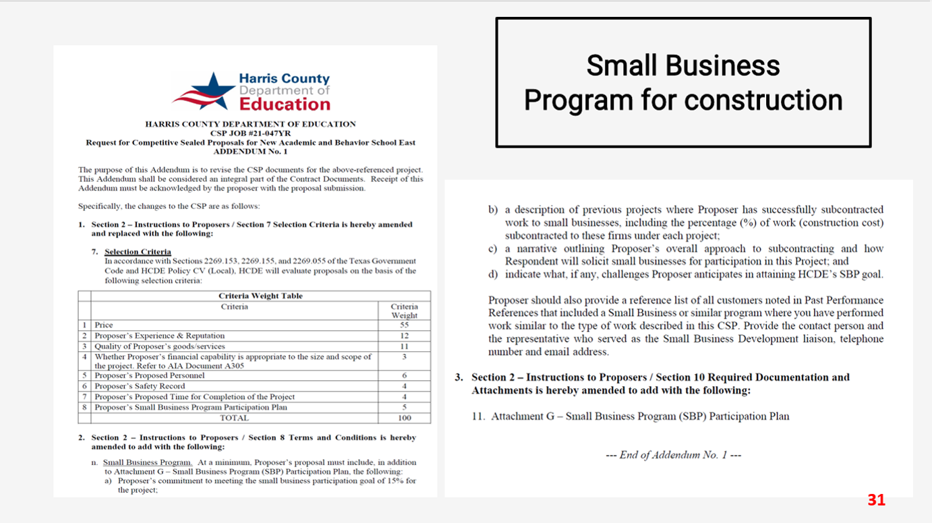
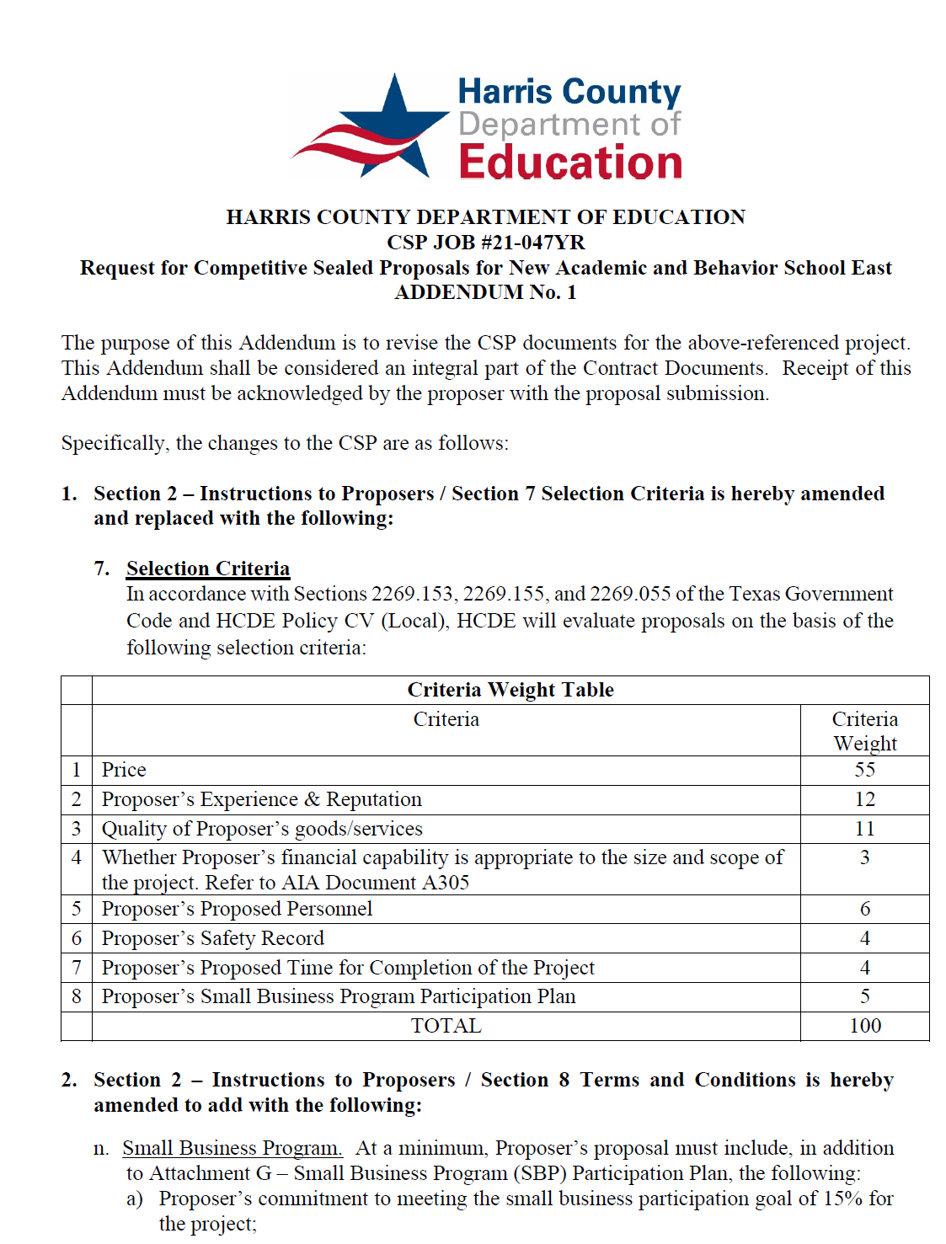

Small Business
Program for construction
Launch industry's first collaboration feature
This is our plan as we launch the industry's first collaboration feature

Slide 32




AB East School Contract $12,358,000 Awarded and Signed
Adult Ed Center Contract $15,121,000 awarded on Oct 2021 Board Mtg
HP East Contract $7,271,000 awarded on Nov 2021
Irvington – Pending Architect Assignment
Cash Balance –
Project Acquisition Account
As of January 31, 2022

Slide 33



Income Statement– Project Acquisition Account
As of January 31, 2022

Slide 34




Capital Program Proposal from Aug 3, 2020

Slide 35








2020 Projected Capital Improvement Program
Project | Substantial Completion Date | Project Budget | Maintenance Notes Projected | Revenue Bonds Proceeds | General Funds Use of Fund Bal. | Interest Earnings Projection
Reagan Adm Bldg. | Feb 9, 2023 | $8,365,500 | $ 8,365,500 | N/A | N/A
Adult Ed Building | Oct 25, 2022 | $18,358,750 | $ 3,659,000 | $12,728,598 | $1,870,000 | $101,153
HP East Middle | Oct 25, 2022 | $7,916,645 | $ 1,089,500 | $4,909,645 | $1,870,000 | $47,500
Ab East Campus | Aug 16, 2022 | $17,805,875 | $ 2,759,000 | $12,943,640 | $2,000,000 | 103,235
 | Total | $52,446,770 | $15,873,000 | $30,581,882 | $5,740,000 | $251,888
 |  | Closed on 12-2-20 | Invested in pools.
Build a product accessible on all devices
This is our plan as we build a product accessible on all devices.
Note: The Total Public Notice was $54,000,000. ($35,000,000 for Revenue bonds and $19,000,000 for Maintenance Notes) on August 10, 2020. A transfer of $1,350,000 plus $50,000 in reimbursable expenditures was made from AB East to allocate Program Manager costs to establish the budgets.
Based on Pricing the principal amount will vary due to the premium projected in the bond sale. Revenues Bonds estimated at $27,730,000 and Maintenance Notes for $13,695,000

Slide 36


Other Capital Projects Underway and Projected
Coolwood Head Start Center to be funded by federal grant $9.5M Est.
Funded through a series of HHS Grants - NOGA Land funded, and Construction
Properties closed – Zieben Property and Houston Parks Board
6311 Irvington Property for Workforce Development – Adult Ed
619 King Ln – Adult Ed. Closed 12/7/21
NOGA received. Due diligence under way for pending property at this time. Schematic design also underway.
Barrett Station and Humble Early Head Start Projects under development $350,000 received from HC Precinct 2

Slide 37




Interim Financial Report (Unaudited)
I certify that the foregoing information is true and accurate to the best of my knowledge.
/s/ Jesus J. Amezcua, RTSBA,CPA, Ph.D., CPFIM, Asst. Supt. for Business Support Services
/s/ Marcia Leiva, Chief Accounting Officer
/s/ Rubi Platero, MBA, Staff Accountant

